Slide 1
Systematic Applications Review Sideology
SARS

Slide 2
Briefing
Systematic Review App is used to refine a queried set of documents down to a suitable number of documents before being further analysed by the user to determine if they are relevant.
These are the 3 stages:
Query Construction
Abstract Evaluation
Document Evaluation

Slide 3
Stage 1 : Query Construction
User constructs queries
Available operations are AND, OR, NOT and XOR.
Users can also group and prioritise queries using parentheses.
Queries can saved.
Saved queries can be opened for further refinement.

Slide 4
Stage 2 : Abstract Evaluation
Abstracts for each document are displayed where they are read by the user
User evaluates each abstract to determine if it is relevant or not.
This relevance is determined by a 2 options.
An additional ‘flag’ functionality is available to the user should an abstract require additional thought.

Slide 5
Stage 3 : Document Evaluation
After abstract evaluation, the user is displayed links to the documents.
The user again, reads through each document and determines its relevance.
The finished product is a database of links to relevant documents.

Slide 6
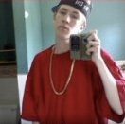
John McHanigan Shanhan tweede McGuiness O'Sweetjesus O'Marey, 24
Occupation: Masters bio-chemistry at Stirling works part time at the royal
ABOUT JOHN
John has a limited amount of time due to his work and university schedules in which to search for papers for study. He also plays the sitar in his spare time thus taking up more of his precious, precious time. The SARS application is of great help in this area as it saves time on searching though unimportant documents and pointless abstracts. John has attempted to use many different searching applications to save time on his study and thus far has deemed SARS to be the most efficient.

Slide 7
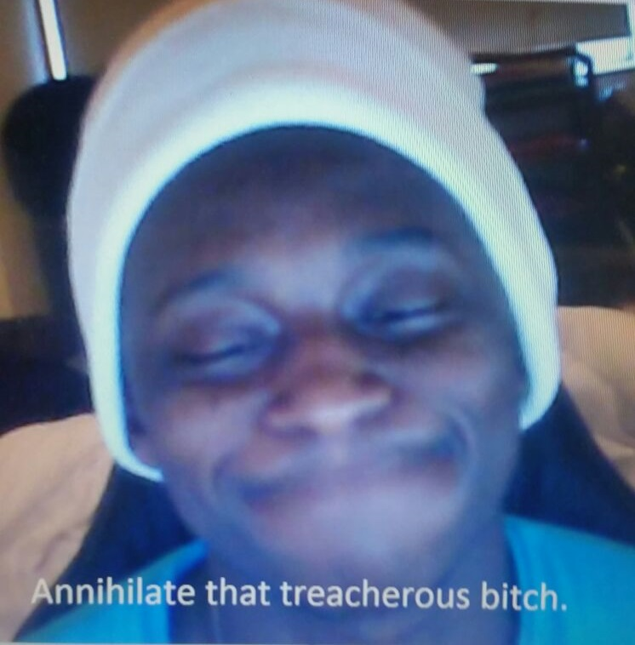
Muhamamad Joshuawawa Omar Fatman Scoop Jr, 75
Occupation: Paediatrician
ABOUT MUHAMMAD
Muhammad's job requires a major amount of time and effort dedicated to it, this leaves Muhammad very little time in which to do research outside of his own knowledge. This app supplies fast, effective results to help him in his medical needs and allows him to further his knowledge in his field.

Slide 8
Specifications
Generate queries
Supply a list of abstracts that meet a certain criteria
Allow the users to determine their relevance to the query
Display documents links related to abstracts that are relevant
Application prompts user for relevance of documents
Store links to relevant documents

Slide 9
High-Level System Architecture

Slide 10
ER Diagram

Slide 11
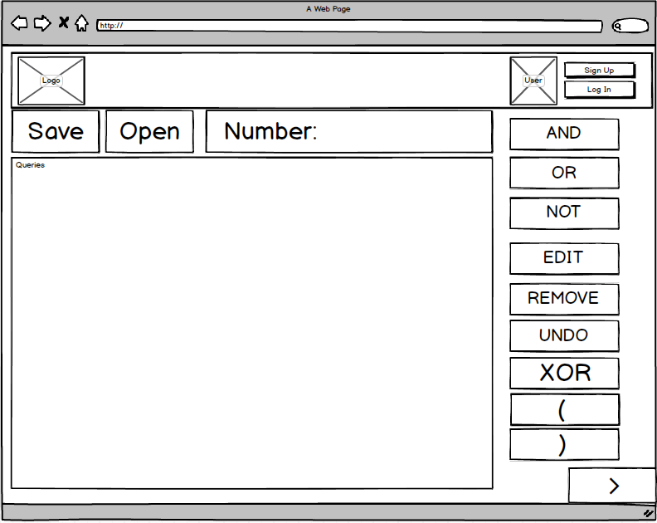
Query Construction Wireframe

Slide 12
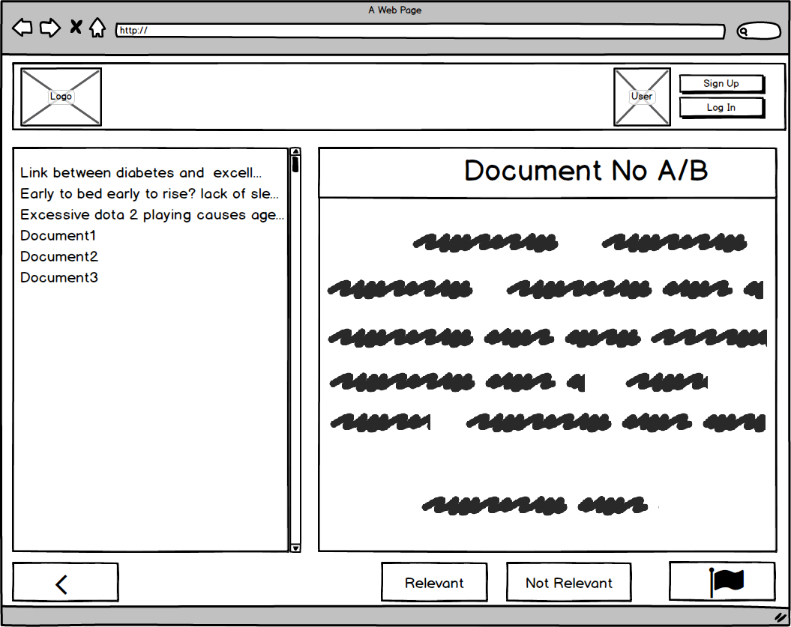
Abstract Evaluation Wireframe

Slide 13
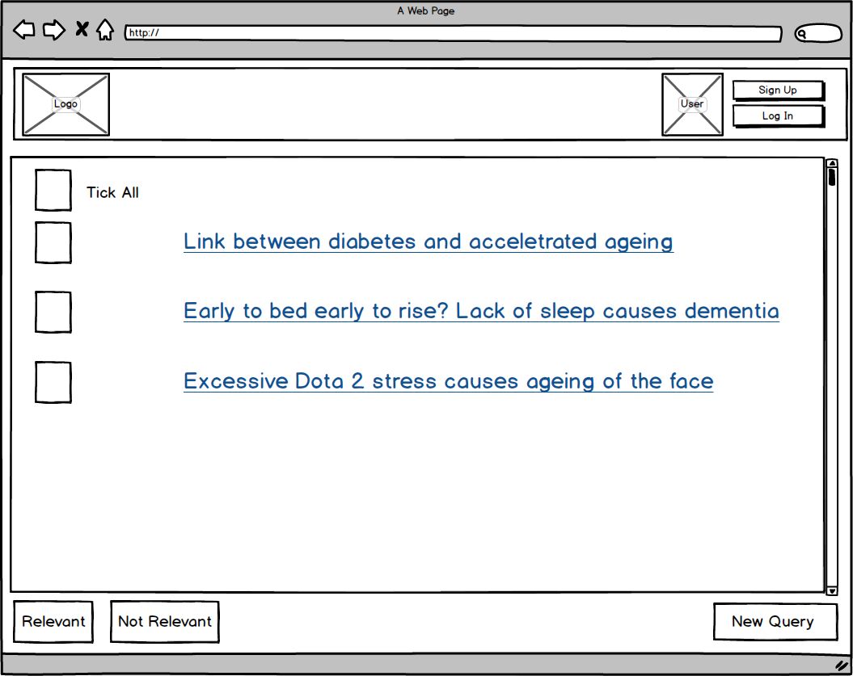
Document Evaluation Wireframe

Slide 14
Specifications
Generate queries
Supply a list of abstracts that meet a certain criteria
Allow the users to determine their relevance to the query
Display documents links related to abstracts that are relevant
Application prompts user for relevance of documents
Store links to relevant documents

